Slide 1
Machine Learning Pipeline Orchestration
Preetam Balijepalli

Slide 2
Key Requirements Consideration for Tool / Technology Selection
Machine Learning Workflow automation — address different steps in the machine learning work flow irrespective of the algorithms and frameworks used
Frequent model deployment(serve) ; Separation of Environments & Jobs - (Training cluster and Serving (Prediction) cluster) to over come pain points like low latency for prediction
Dynamic (Some task that needs to be repeated an unknown number of times) and Parameterized Workflows
Fit into the existing architecture and Compatible with future releases of the frameworks that are used
Versioning (It is not enough for code to work – Robert C Martin)— Sometimes DAG would change when we support multiple versions of the same model or multiple models in order to do A/B testing
Scheduling (Event and Time ,Continuous Monitoring of models)
From a cost and community support perspective.
Extensible and encourage reusability of tools/techniques
Ease of Use : UI(I want to believe - Fox Mulder)
Local Testing
Support Diverse Set of Programming Languages or Frameworks :Python , R , Scala , Julia , Spark , TensorFlow etc.
Scalability and HA

Slide 3
 | Airflow | Azkaban | Conductor | Oozie | Step Functions
Owner | Apache (previously Airbnb) | LinkedIn | Netflix | Apache | Amazon
Community | Very Active | Somewhat active | Active | Active | N/A
History | 6 years | 9 years | 3.5 years | 10 years | 3.5 years
Main Purpose | General Purpose Batch Processing | Hadoop Job Scheduling | Microservice orchestration | Hadoop Job Scheduling | General Purpose Workflow Processing
Flow Definition | Python | Custom DSL | JSON | XML | JSON
Support for single node | Yes | Yes | Yes | Yes | N/A
Quick demo setup | Yes | Yes | Yes | No | N/A
Support for HA | Yes | Yes | Yes | Yes | Yes
Single Point of Failure | Yes (Single scheduler) | Yes (Single web and scheduler combined node) | No | No | No
HA Extra Requirement | Celery/Dask/Mesos + Load Balancer + DB | DB | Load Balancer (web nodes) + DB | Load Balancer (web nodes) + DB + Zookeeper | Native
Cron Job | Yes | Yes | No | Yes | Yes
Execution Model | Push | Push | Poll | Poll | Not Defined (Can do both)
Rest API Trigger | Yes | Yes | Yes | Yes | Yes
Parameterized Execution | Yes | Yes | Yes | Yes | Yes
Trigger by External Event | Yes | No | No | Yes | Yes
Native Waiting Task Support | Yes | No | Yes (external signal required) | No | Yes
Backfilling support | Yes | No | No | Yes | No
Native Web Authentication | LDAP/Password | XML Password | No | Kerberos | N/A (AWS login and IAM )
Monitoring | Yes | Limited | Limited | Yes | Limited
Scalability | Depending on executor setup | Good | Very Good | Very Good | Very Good

Slide 4
Comparison of Step Function Vs Airflow
Workflow mechanism in Google Cloud is Airflow , Step Function in AWS
AWS Step Functions started as tool to orchestrate Lambda functions (can now do Fargate tasks and ECS tasks), built into pre-built AWS solutions (for example: https://aws.amazon.com/solutions/media-analysis-solution/?did=sl_card&trk=sl_card)
Airflow was created as a CRON replacement (CRON on steroids)
AWS Step Function Manages state, highly durable, scalable, you don’t have to maintain the software (however Airflow is available as managed service from Google GCP Cloud Composer and Astronomer Cloud)
AWS Step function “DAGs” are defined in JSON(Stage Language), not Python(Meta Programming) - it’s easier to compose JSON than Python, and tasks can be written in any language (this is true in Airflow w/ DockerOperator and KubernetesPodOperator) - however it’s less flexible, in some cases critically so - can’t dynamically generate DAGs, tasks, etc. meta-programming is one of the primary strengths of Airflow, you can read a database table and generate 100's of DAGs with a short python script.
You have no choice but to define the DAG separately from the execution code
Impossible to develop iteratively, locally - AWS IAM all over the place
Nothing like backfill in AWS Step Functions (that I can see) , AWS has and from since version 1.8, Airflow lets you control this behaviour using catchup. Either set catchup_by_default=False in airflow.cfg or catchup=False in your DAG definition.
Seems like Step Functions is more for triggered jobs rather than CRON scheduled , if you want to do it as a secheduled job you need to do it with help of cloud watch https://blog.skbali.com/2018/12/schedule-run-of-step-function/
The best abstraction for software is code: In Airflow everything lives in a code repo - in Step Functions you’re clicking around in AWS setting things up - Not portable, hard to see everything for a project, no commit history/blame . You can use terraform/cloud formation to define everything, then you have history/control
Step Functions monitoring is available from UI, CLI, API, but has nothing like Airflow UI (purpose built UI for Day 2+ operations - finding failures, retrying, etc - monitoring performance)
Sub Dag-like functionality is possible in Step Functions (by nesting AWS State Machines) but it doesn’t feel as put together
Step functions is not open source - You can’t contribute to make it better - Your work isn’t portable (AWS lock in)
With Airflow, you can run on-prem, any cloud, etc
With Airflow, you can already find several Airflow operators for machine learning platforms like Google DataFlow, Amazon SageMaker and Databricks.

Slide 5
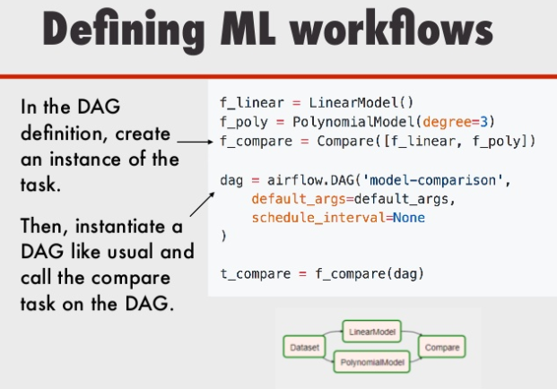
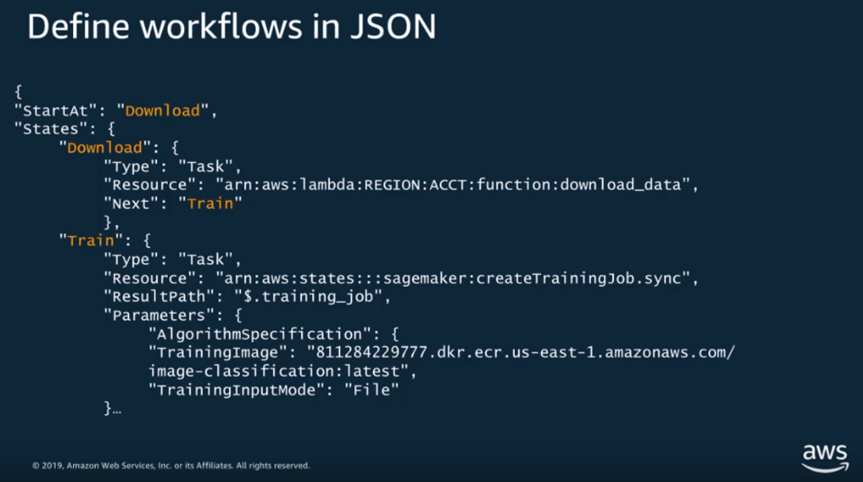
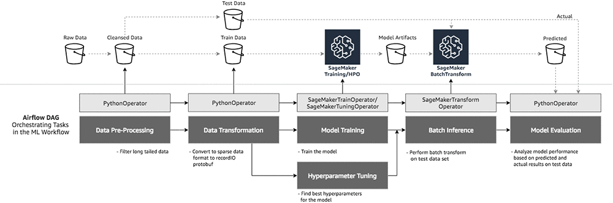
Example
https://aws.amazon.com/blogs/machine-learning/build-end-to-end-machine-learning-workflows-with-amazon-sagemaker-and-apache-airflow/
https://aws.amazon.com/blogs/machine-learning/automated-and-continuous-deployment-of-amazon-sagemaker-models-with-aws-step-functions/

Slide 6
To Evaluate
MetaFlow
TensorFlow Extended
Kubeflow is a Kubernetes native orchestration framework for Machine Learning workflows. Powered by Argo, it allows for orchestrating complex, multi-step pipelines. Tightly integrated with Kubernetes, it manages your pods and offers a simple UI to kick off and track your jobs.
Data Robot : Licensed
zflow : an SDK in Python that leverages the power of AWS CDK, AWS Lambdas and AWS Step Functions to build powerful end-to-end Machine Learning workflows by just imperatively specifying it in a single Python file
Custom Python Script

Slide 7
References and Comparison of Cost:
TO ADD

Slide 8


Thank You !

